Slide 1
Cell nuclei segmentation: clustering
Project Proposal - DataScience SS20 - Project 2 Group 4
Julia Braun, Marika Högner, Stefanie Mantz
Notes:
Julia

Slide 2
Project goals
Quantifying cell nuclei manually entails
Subjective decision
Low reproduceability
Time-consuming
Solution:
Automated cell nuclei segmentation based on clustering
Automated cell nuclei quantification and data mining (e.g. counting)
Literature:
Diversity of clustering algorithms! Compare Estivill-Castro, 2002. https://doi.org/10.1145/568574.568575
Diversity of applications! Compare Koyuncu et al. 2018 https://doi.org/10.1002/cyto.a.23594, Fouad et al., 2017 2018 https://doi.org/ 10.1371/journal.pone.0188717
Notes:
Julia

Slide 3
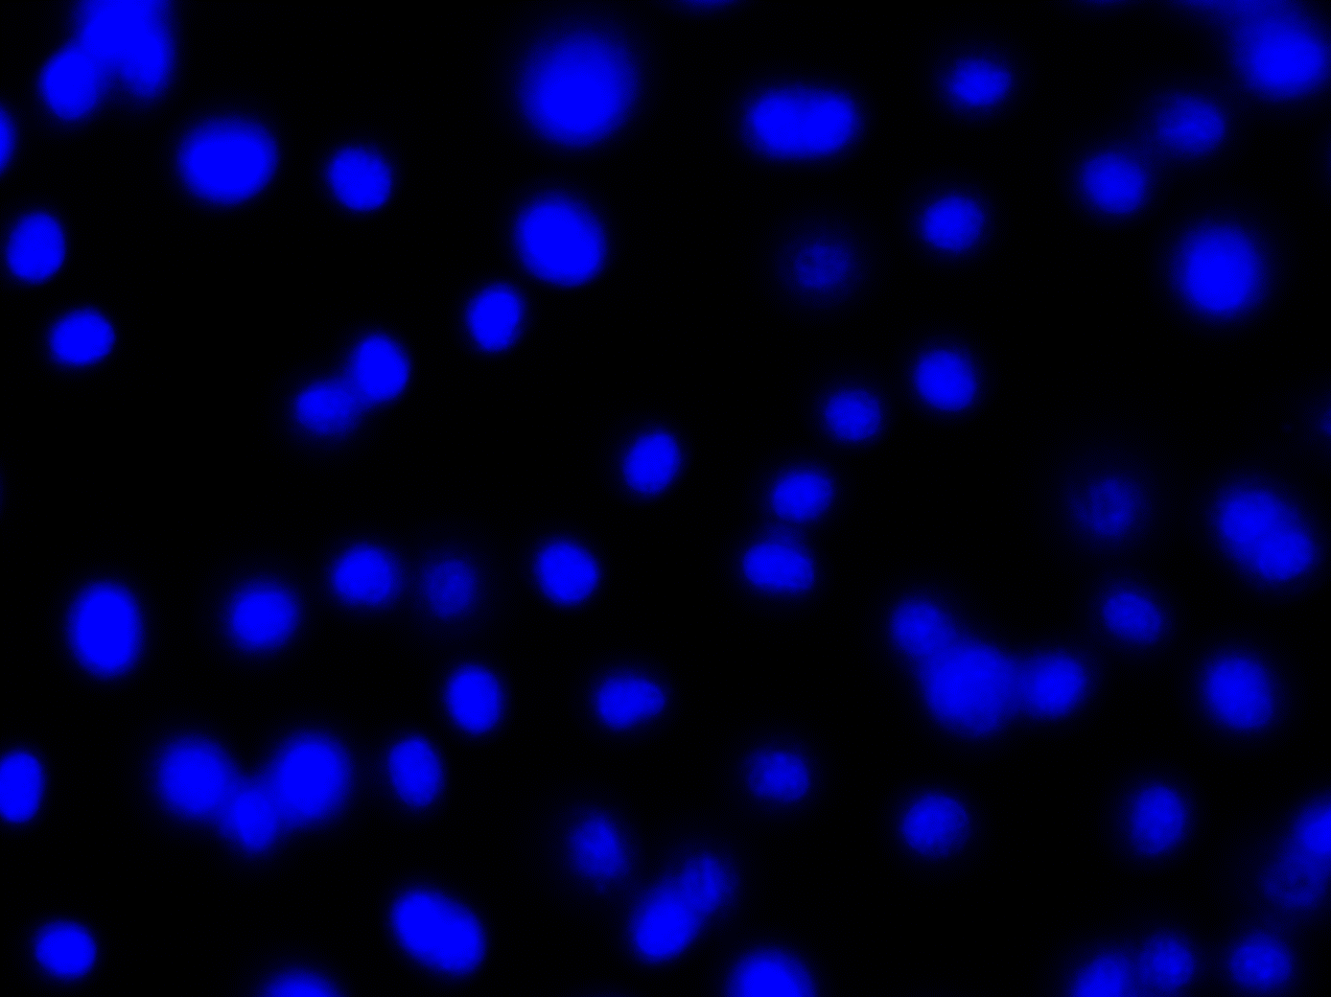
Dataset
Fluorescent image, only nuclei.
Fluorescent image, entire cell.
25 images (1388×1040)
Fluorescence microscopy (DAPI stain)
Murine bone-marrow derived macrophages
30–50 cell nuclei per image
Broad Bioimage Benchmark Collection (BBBC)
Original images: BBBC020_v1_images
Ground-truth: BBBC020_v1_outlines_nuclei
Benchmark: compare algorithms
Ground-truth as a common reference point!
Ground-truth image.
Notes:
Julia
BBBC erklären → Bild-Datenbank zum standardisierten Vergleich von Algorhythmen
Auf Biologische Bedeutung dieser Art Bilder eingehen

Slide 4
Logical algorithm flow
Input: Image
Filtering and pre-processing
Segmentation – K means clustering
Output: Segmented image, amount of nuclei ...
Data mining: Count nuclei
Performance evaluation: Dice score
Notes:
Julia
logical project flow: image --> filtering/preprocessing --> segmentation/clustering --> Dice score --> output (of image, of test values)

Slide 5
1. Milestone: Implement evaluation measure
Delivers: measure to compare two images
tests the performance of our segmentation method
compares the segmentation with the control
Planned analysis steps:
Write a Dice-score-function on our own
unit testing: tests the performance of the Dice-score-function using mock objects → synthetic images
Write a function that generates synthetic images
Notes:
Marika
Test-driven-design → we start by writing the evaluation of our main method
Mock-object → simulates object, that mimics the behaviour of real objects

Slide 6
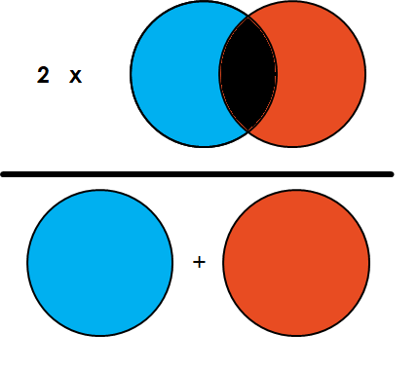
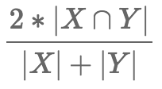
Dice Score
Statistical method to evaluate the similarity of two samples
Compares output with the ‘ground truth’
In our case: segmented image ↔ control image
Output: Value between 0 and 1
0 → no match
1 → complete match
https://towardsdatascience.com/metrics-to-evaluate-your-semantic-segmentation-model-6bcb99639aa2, accessed 18.05.2020
https://forums.fast.ai/t/understanding-the-dice-coefficient/5838 accessed 18.05.2020
Notes:
Marika
Genauere Erklärung des Dice score anhand der Formel und der Grafik

Slide 7
2. Milestone: Implement image segmentation
Delivers image with labelled pixels
Should result in two labels: ‘cell nuclei’ and ‘background’
Planned analysis steps:
Write a K-means-function on our own
Test the performance with the Dice-score-function, using the control images
Notes:
Marika

Slide 8

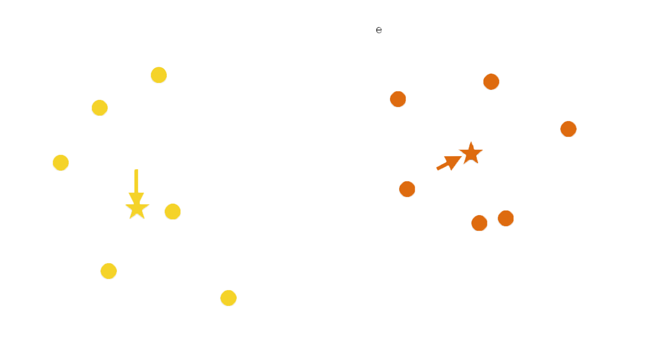




K means clustering
Choose k random points → centers
Assign each datapoint to the nearest center → cluster
Update centers of each cluster → mean value of cluster
Assign each datapoint to the nearest new center → new cluster
Repeat steps 3. & 4. until:
Predefined maximum number of iterations is reached
No datapoint changed its cluster
Source: Lecture Computer Science
Dr. Carl Hermann
Notes:
Steffi
c. Predefined accuracy is reached ?

Slide 9
3. Milestone: Implement pre-processing methods
Delivers: images, that yield better clustering results
Denoise the image
Separate nuclei, that appear fused due to the segmentation method
Planned analysis steps:
Write gaussian-filter-function to reduce noise
Find a method to separate nuclei that appear fused after segmentation (e.g. Opening, Watershed)
Notes:
Steffi
Better results = Dice score closer to 1
Fused nuclei that in reality are not fused! → prevent loosing too much detail during k means

Slide 10
4. Milestone: Counting the nuclei after segmentation
Delivers: amount of cell nuclei in the image
Planned analysis steps:
contouring after segmentation → counting the amount of contours (each nuclei has one circular line enclosing it = contour)
Notes:
Steffi
Needs: Segmentation of nuclei that appear fused but are not fused

Slide 11
Timeline
Dice score
K means
Pre-Processing
Counting
21.05. – 03.06.
04.06. – 17.06.
18.06. – 01.07.
02.07. – 15.07.
Notes:
Steffi

Slide 12
Thank you for your attention!

